Slide 1



InBody Application in Cancer

Slide 2






Slide 3
Introduction
What are the main highlights?

Slide 4











01 Introduction
The complex cancer journey
Different parameters should be highlighted depending on the type of cancer
Pre-diagnosis
Cancer diagnosis
Treatment decision
Active treatment
Remission
Recurrence
End-of-life

Slide 5





01 Introduction
The complex cancer journey
Different parameter should be highlighted depending on the type of cancer
Pre-diagnosis
Cancer diagnosis
Treatment decision
Active treatment
Remission
Recurrence
End-of-life

Slide 6

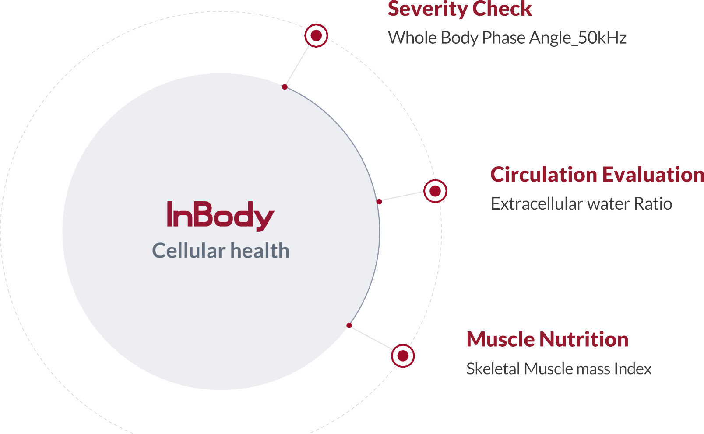

01 Introduction

Slide 7
Application of InBody
Understanding core indicators and their use

Slide 8
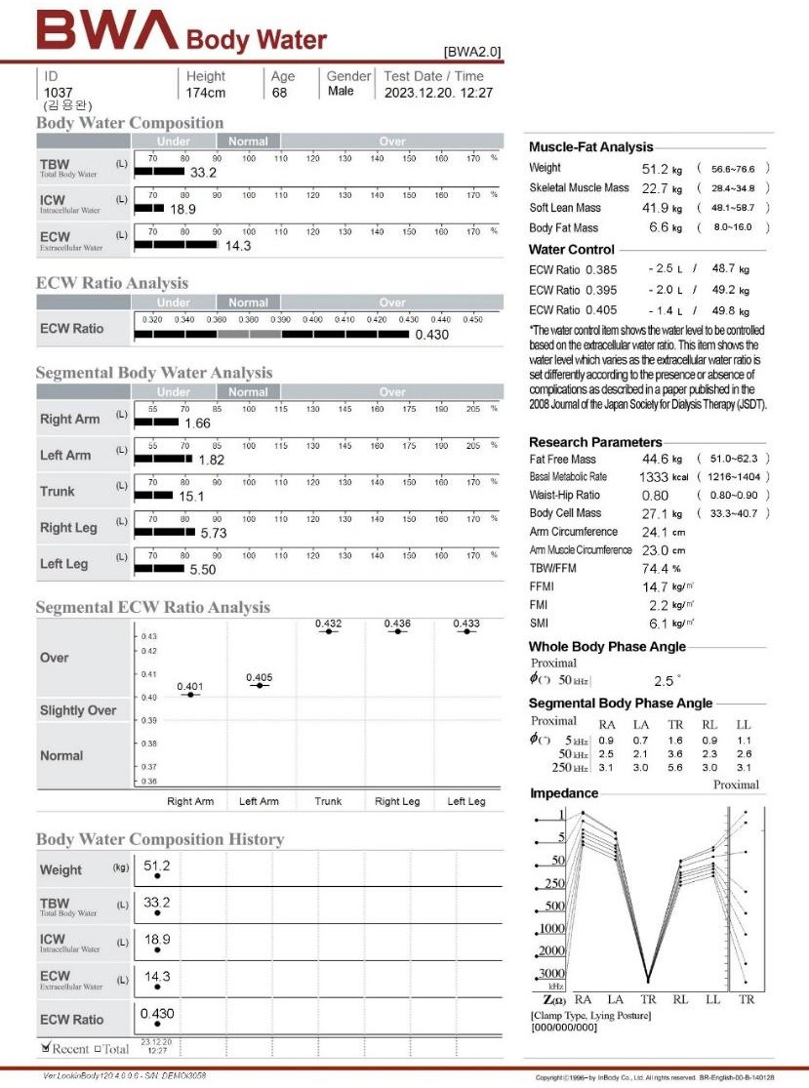


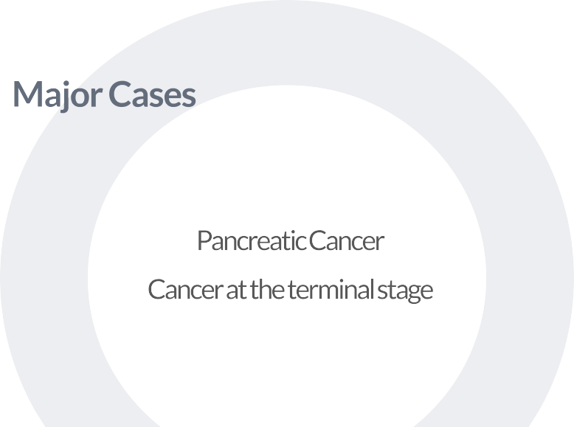
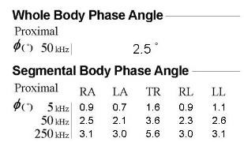
02 Application of InBody
01

Slide 9



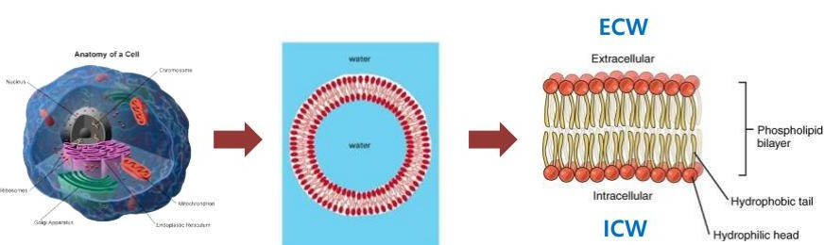
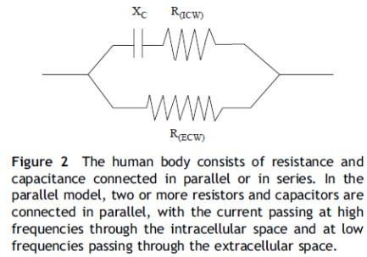
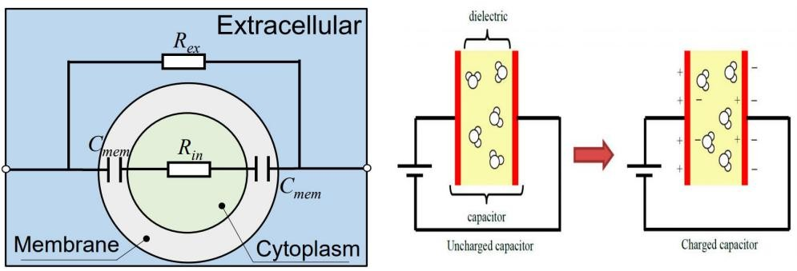
02 Application of InBody
Cell membranes consist of two layers of lipoproteins, the inner layer is Hydrophobic & the out layer is hydrophilic
→ Act as condenser
Xc represents the resistance component originating from the cell membrane, which acts as PhA is directly proportional to Xc
→ PhA is associated with the health status of cells/cell membranes

Slide 10
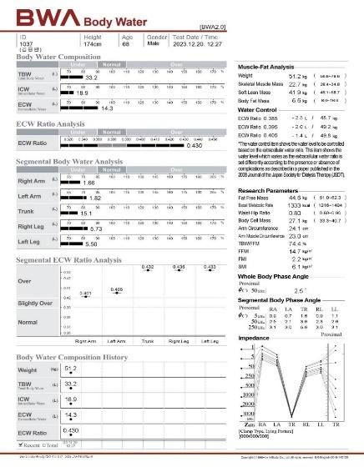
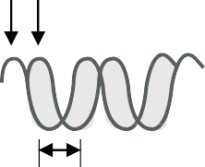
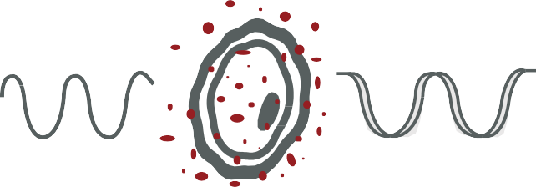



02 Application of InBody
Shows a strong correlation with the nutritional status & survival of cancer patients
Healthy Cell
Damaged Cell
Membrane
U max I max
50KHz
50KHz
>4º | Normal
3-4º | Make interpretation based on age
<2º | Serious nutrition state
Phase Angle
Intact cells with high membrane integrity
Damaged cell or low cell density
High Phase Angle
Low Phase Angle
Improvements in cell membrane and functionality → Phase angle increase
Deterioration cellular integrity and selective permeability → Phase angle decrease

Slide 11



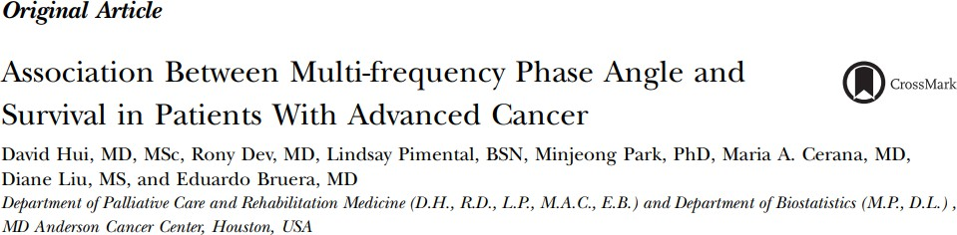
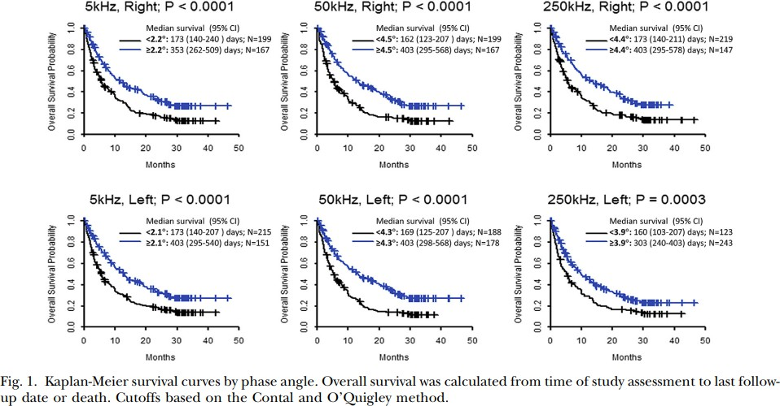
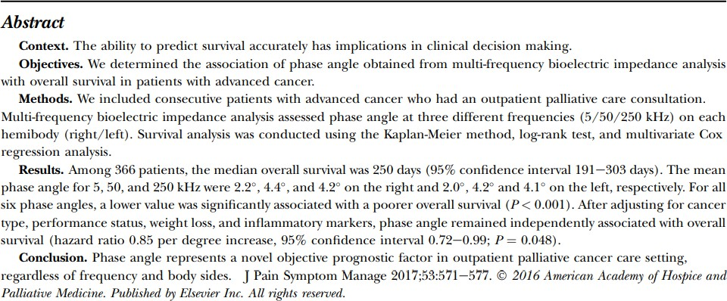
02 Application of InBody
The average PhA at 50kHz of a cancer patient who survived 205 days was 4.4º Lower PhA were associated with poorer prognosis

Slide 12
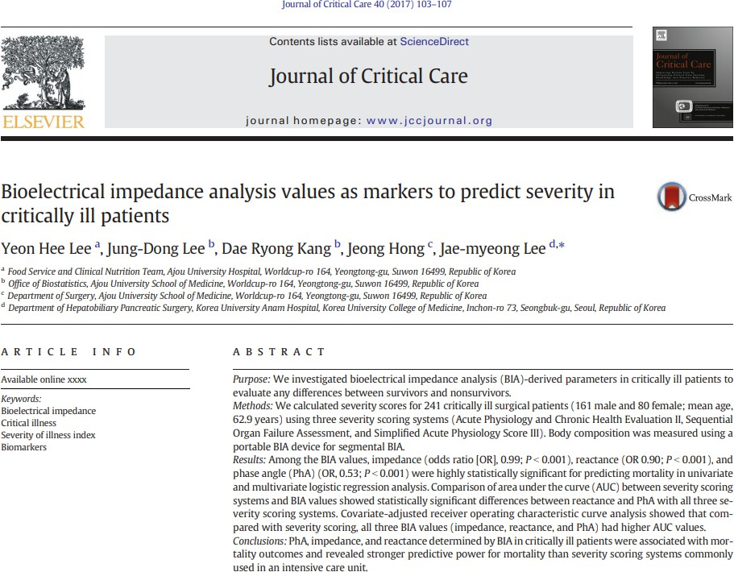
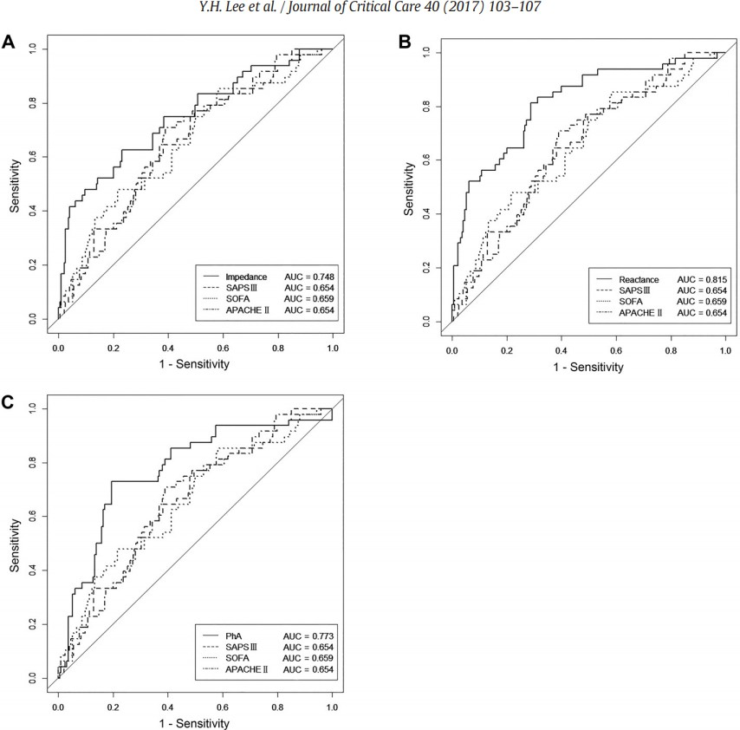
02 Application of InBody
PhA in critically ill patients was associated with mortality outcomes
& revealed stronger predictive power for mortality than severity scoring systems commonly used in the intensive care unit.

Slide 13
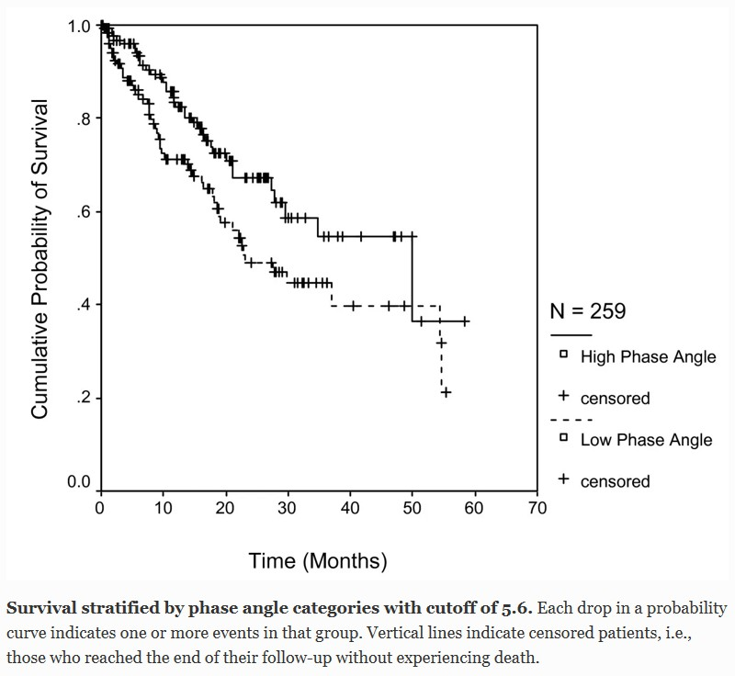
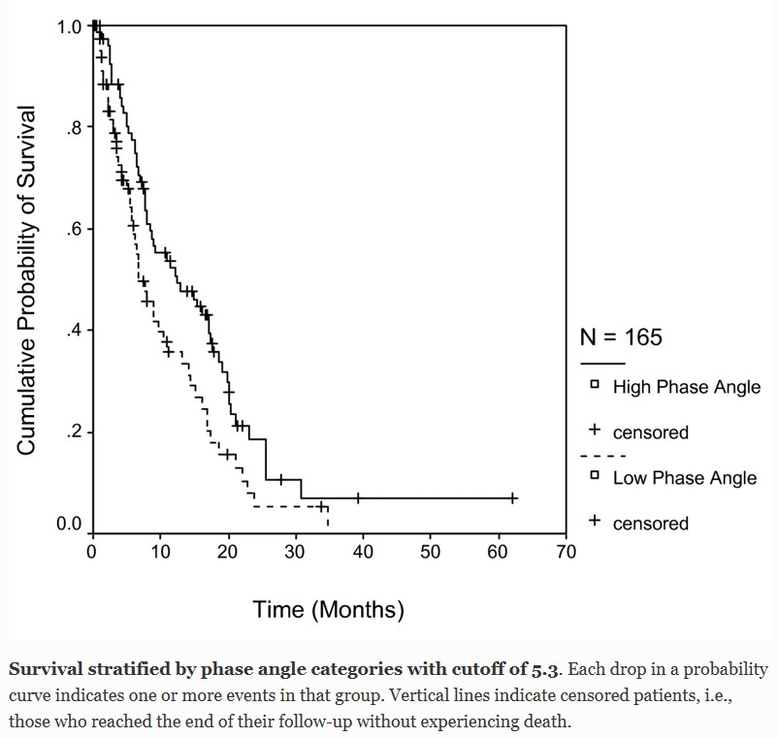
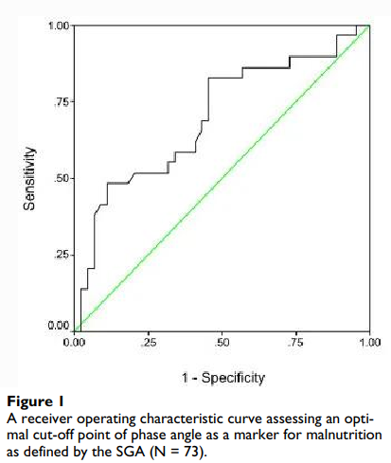
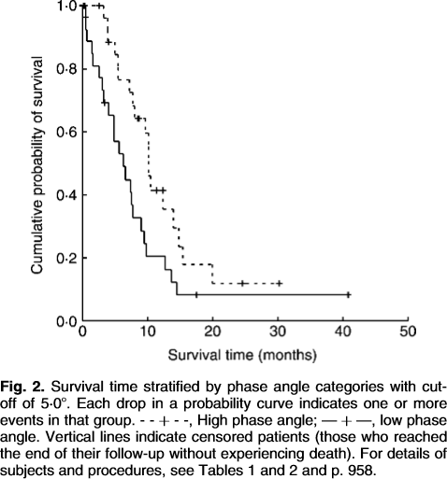
02 Application of InBody
PhA in predicting survival rate of patients with different types of cancer
N = 29
(Total 58)
Bioelectrical impedance PhA as a prognostic indicator in breast cancer. BMC Cancer 2008
Bioelectrical impedance PhA in clinical practice: implication for prognosis in stage IIIB and IV non-small cell lung cancer.
BMC Cancer 2009
The relationship between bioelectrical impedance PhA and subjective global assessment in advanced colorectal cancer. Nutrition J 2008
Bioelectrical impedance PhA as a prognostic indicator in advanced pancreatic cancer. British J of Nutrition 2007

Slide 14

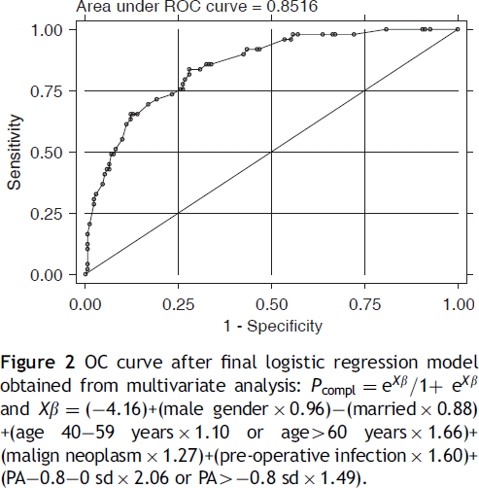
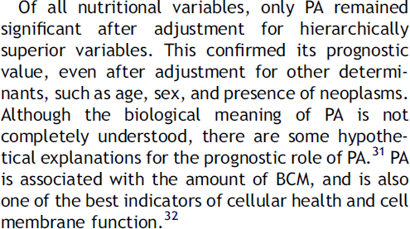
02 Application of InBody
PhA is a valuable predictor of postoperative outcomes

Slide 15
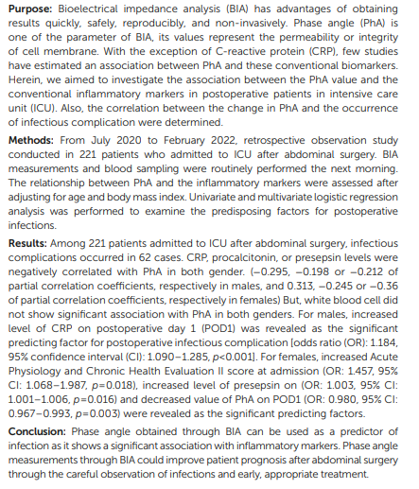
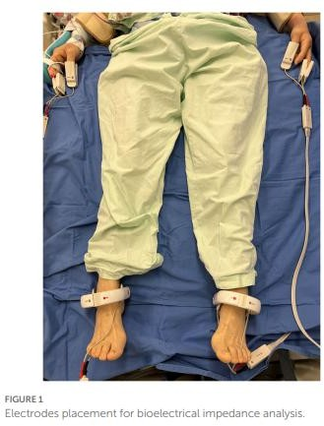
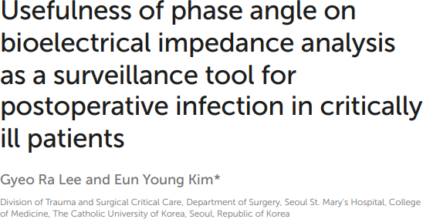

02 Application of InBody
PhA obtained through BIA can be used as a predictor of infection as it shows a significant association with inflammatory markers

Slide 16


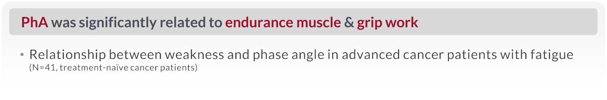
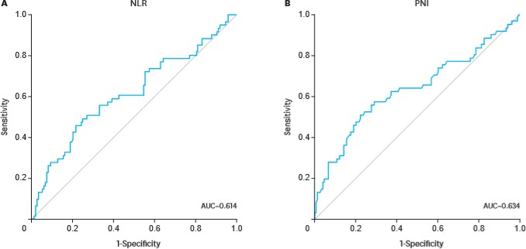


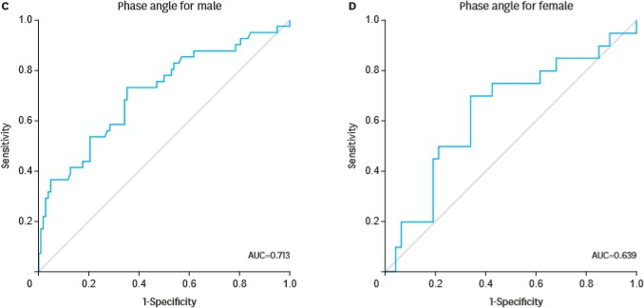

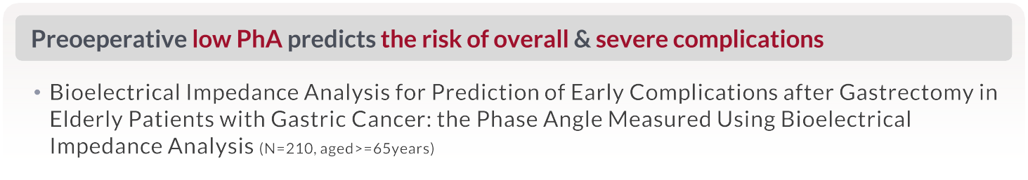
02 Application of InBody
Support Care Cancer (2013)
↑
↓
↑
↓
Nutrition and Cancer (2018)
J Gastric Cancer (2019)

Slide 17
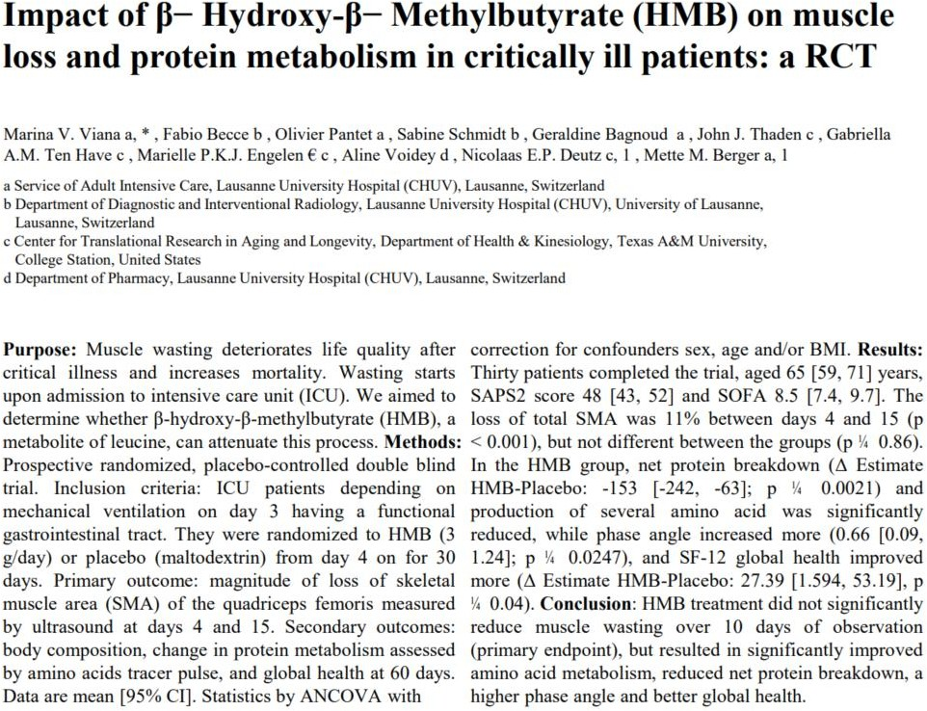
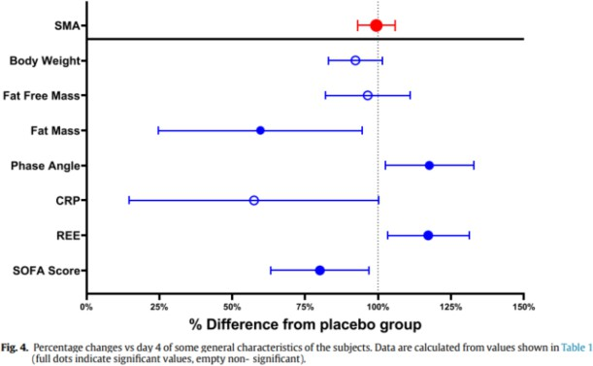
02 Application of InBody
HMB therapy improved amino acid metabolism, reduced protein breakdown, and increased the PhA

Slide 18
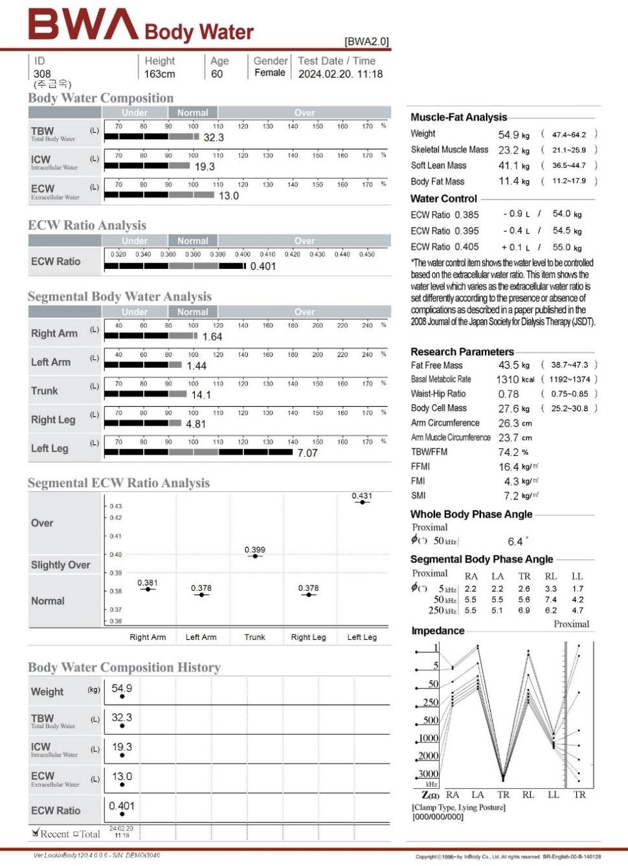

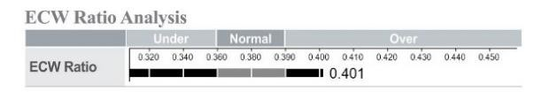

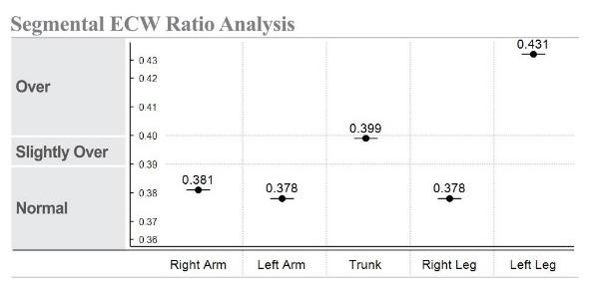
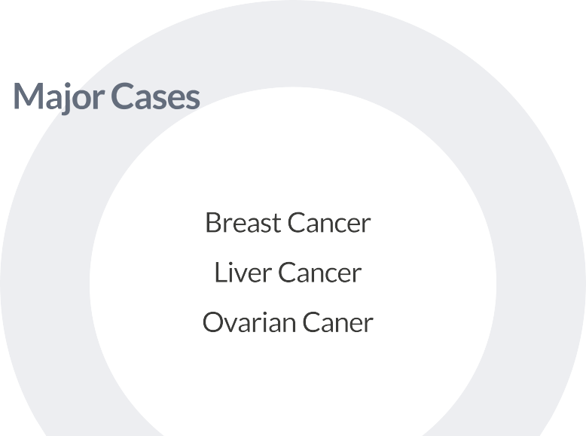
02 Application of InBody
02

Slide 19


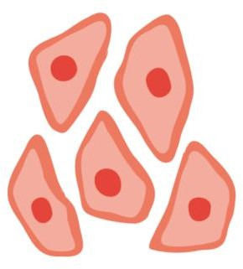


02 Application of InBody
proportion of extracellular water to total body water
Extracellular Water (ECW) / Total Body Water (TBW)
Edema ECW/TBW > 0.400
2 possibilities
Case 1.
Increase of ECW
Case 2.
Decrease of ICW
Normal ECW/TBW = 0.380
Intracellular water
ICW
Over-hydrated
Extracellular water
Extracellular water
ECW
ECW
Normal Extracellular water
ECW
40%
ECW
38%
40%
Total
ICW
ICW
Body water 100%
Normal Intracellular water
ICW
Dehydration
Low Intracellular water
62%
60%
60%
Acute kidney failure, Chronic kidney disease, Post-surgery Etc.
Malnutrition, Aging, Cachexia, ALS Etc.
0.380

Slide 20
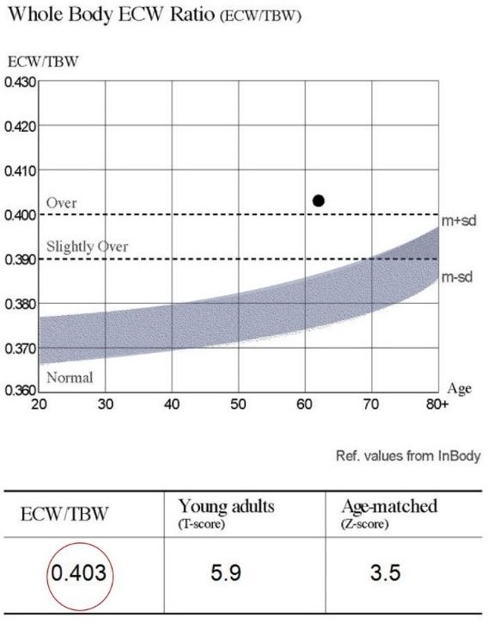
02 Application of InBody
Can assess circulatory status & evaluate edema, a side effect of chemotherapy
 | Normal | Mild Edema | Edema
ECW Ratio | 0.360~0.390 | 0.390~0.400 | >0.400
√
Excessive ECW compared to ICW,
It may indicate potential health issues such as hormonal imbalances, excessive salt intake, or a high level of toxins in the body
√
When ICW is sufficient,
Adequate nutrients can be transported into cells which can support cellular metabolism, aiding in energy production
Edema if
Above 0.390

Slide 21


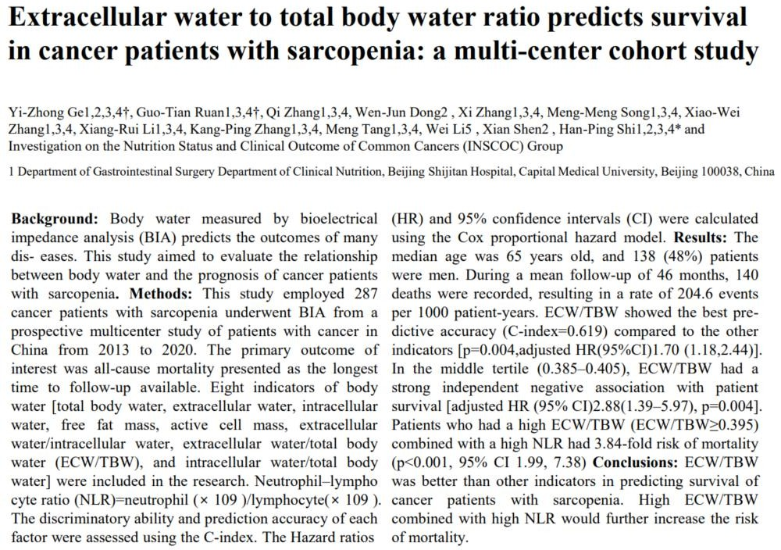
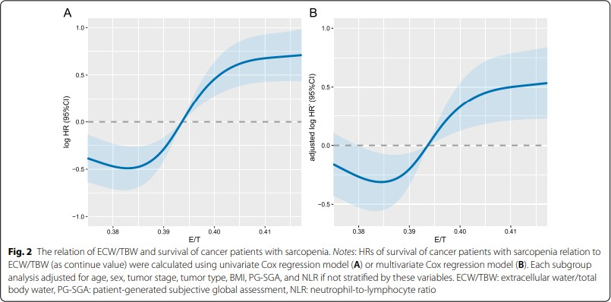
02 Application of InBody
In cancer patients with sarcopenia,
the ECW/TBW ratio is more significant than any other clinical indicator in predicting survival rates High ECW ratio & NLR(Neutrophil-to-Lymphocyte Ratio) further increase the risk of mortality

Slide 22
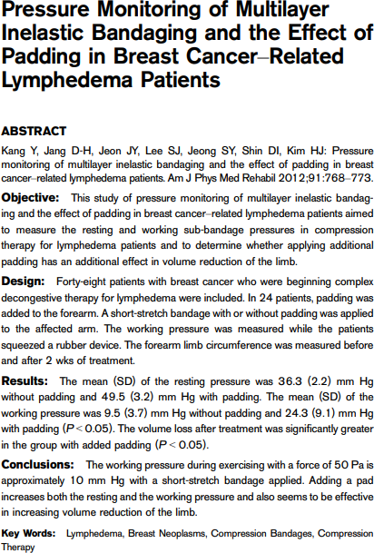
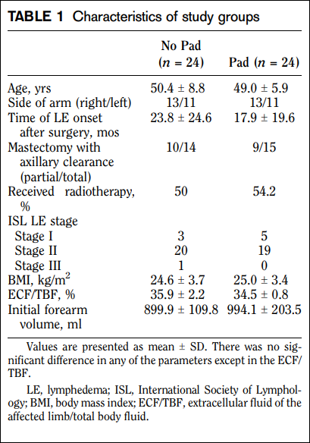
02 Application of InBody
Early diagnosis of lymphedema (with a difference in impedance of over 10% between the arms) can be used for assessing treatment effectiveness & predicting treatment outcomes

Slide 23

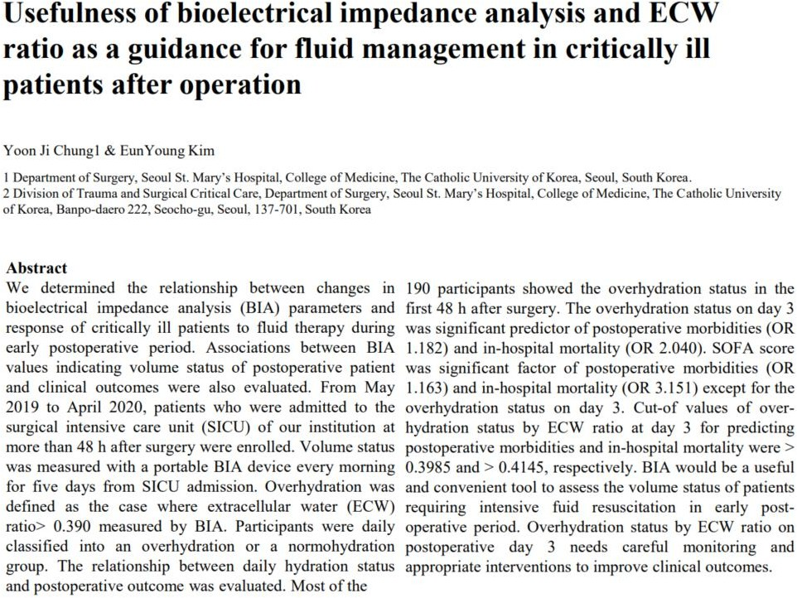
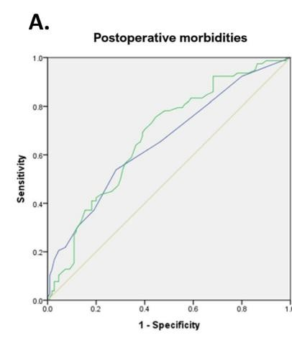
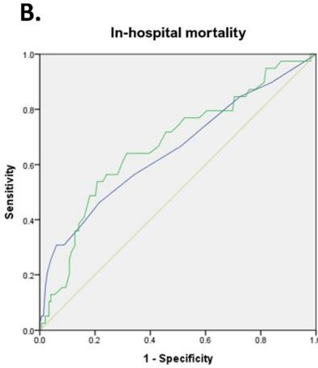


02 Application of InBody
Overhydration status by ECW ratio on postoperative day 3 needs
careful monitoring and appropriate interventions to improve clinical outcomes

Slide 24
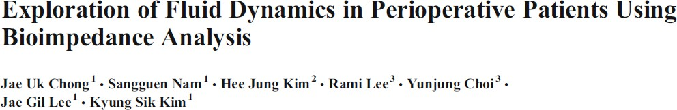
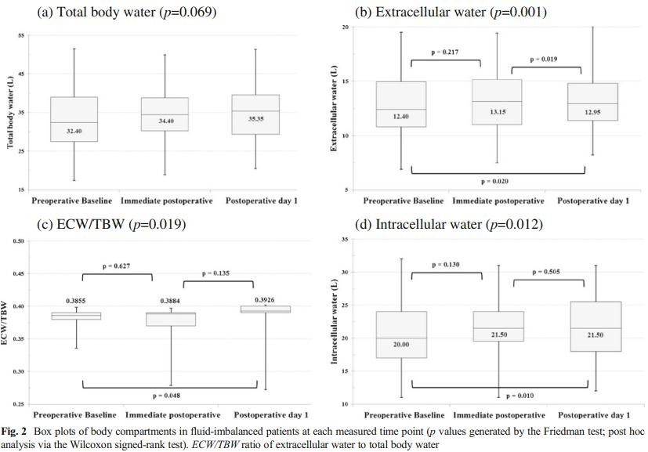
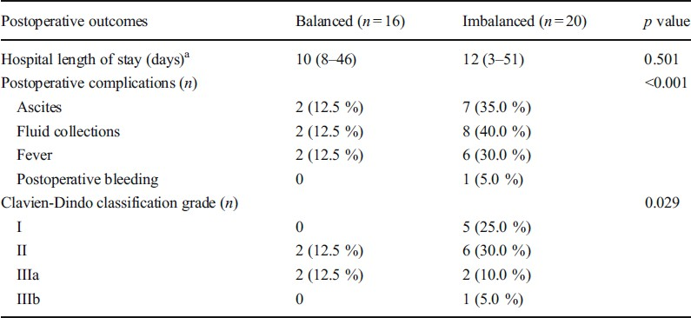
02 Application of InBody
Patients with an imbalanced ECW ratio had a 2.8 times higher risk of complications
such as ascites & fluid accumulation compared to those with a balanced ratio

Slide 25
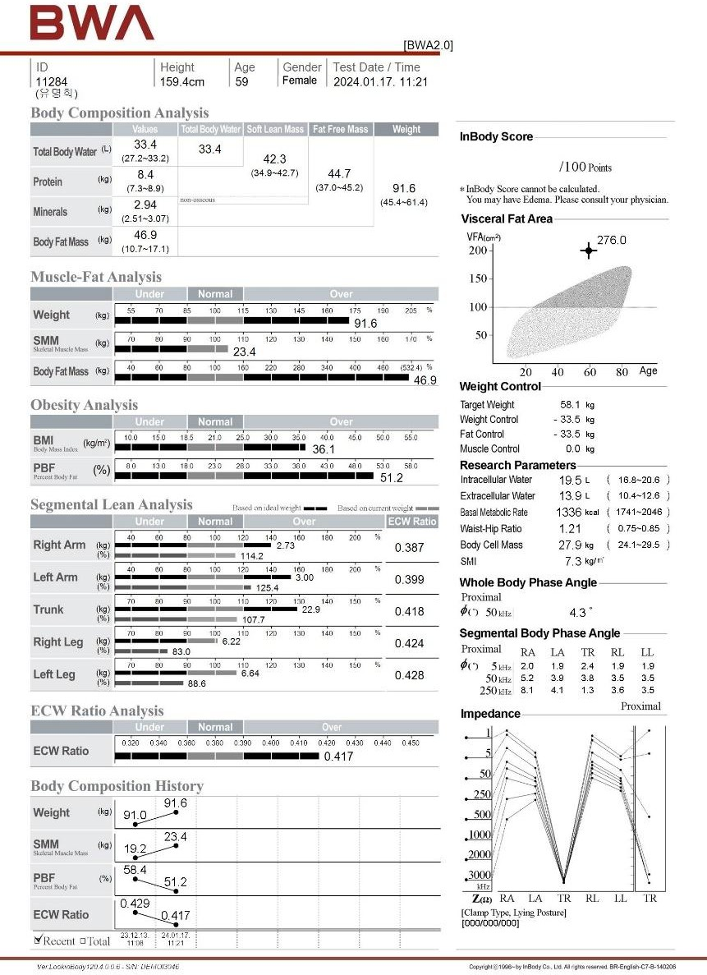


02 Application of InBody
03
√

Slide 26


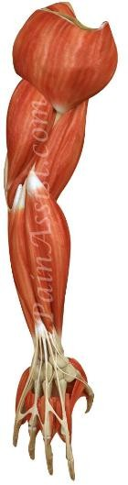
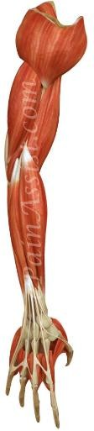
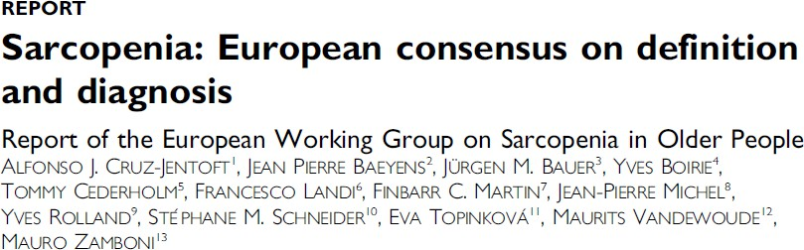


02 Application of InBody

Slide 27


02 Application of InBody
Age 41, 173cm, 64kg
Limb SMM ÷ height squared
(2.50 + 2.61 + 6.45 + 6.43) ÷ 2.99 = 6.01

Slide 28






















02 Application of InBody
+
+
√
Fig 1. AWGS 2019 algorithm for sarcopenia. F, female; M, male. (Chen et al., 2020)

Slide 29

02 Application of InBody
Primary clinical condition
Aging
Secondary clinical conditions
Disease, Nutrition, Functional decline
Disease : Cancer, diabetes, chronic disease, degenerative neuronal disease, autoimmune disease, etc.
Nutrition : Malnutrition, intake limitations due to dental abnormalities,
AWGS 2019 algorithm for sarcopenia (source: Chen et al., 2020)
decreased absorption of nourishment due to cancer surgery, etc.
Functional decline: Decreased activity level, reduced exercise, social avoidance due to depression, etc.

Slide 30










02 Application of InBody
[Changes due to Cancer-Induced Cachexia]
Significant weigh loss
Muscle loss
Resistance to standard treatment
(Chemotherapy/Radiation)
Impossible to live normal life
[Criteria for Diagnosing Cachexia]
Weight loss > 5% over the past 6 months
BMI < 20 + Weight loss > 2%
–
Severe skeletal muscle loss

Slide 31


02 Application of InBody
Sarcopenia
Cachexia
Inflammatory-related diseases (e.g. Cancer, AIDS, Sepsis, etc.)
Age-related Chronic Inflammation
The prevalence of sarcopenia before starting treatment in cancer patients ranges from 15% to 75%
It is particularly high in patients with gastrointestinal cancers,
and the prognosis is poor if sarcopenia is present at the time of diagnosis
Muscle Atrophy
Loss of Muscle Mass
Even if sarcopenia is not present initially in cancer patients,
the prognosis is poor if sarcopenia develops or worsens during chemotherapy
Disability Diminished Quality of Life
Mortality

Slide 32







02 Application of InBody
Sarcopenia is associated with an increased risk of advanced Colorectal Neoplasia
International Journal of Colorectal Disease 2017;32:557-565

Slide 33


02 Application of InBody
Sarcopenia is prevalent among elderly Gastric Cancer patients as well as the development of severe postoperative complications
Gastric Cancer 2016;19:986-993

Slide 34



02 Application of InBody
The survival rate of sarcopenic liver transplant patients is significantly lower compared to those with normal or high SMM (p<0.001)

Slide 35




02 Application of InBody
Decreases in FFM(fat free mass) & AC(arm circumference) in patients with gastric, hepatobiliary, and pancreatic cancers serve as indicators of reduced muscle mass & malnutrition, which are associated with survival outcomes

Slide 36







02 Application of InBody
Reduced muscle pump function (decreased venous return)
Impaired physical activity (sedentary life style, venous insufficiency)
High fat mass (inflammation, insulin resistance...)
Age related changes (hormonal changes, drugs...)
About the muscle quality
Muscle
Normal healthy people ECW/TBW = 0.380
Edema
ECW/TBW > 0.390
Best result | Not good
Not good | Worst result
Fluid overload
Eu-hydrated Fat Free Mass
Extracellular water (ECW)
Extracellular water (ECW)
397
____
380
____
Edematous Fat Free Mass
Cut off
(100%, bottom bar)
Intracellular water
620
Intracellular water
603
(ICW)
(ICW)
Protein + Minerals
Protein + Minerals
0.390
ECW Ratio

Slide 37








02 Application of InBody
[59 years old hemodialysis patient’s adjusted SMI Calculation]
Right arm 2.73 kg Left arm 3.00 kg Right leg 6.22 kg Left leg 6.64 kg SMI = 7.3 kg/m²
Right arm 2.73 kg – excessive ECW Left arm 3.00 kg – excessive ECW Right leg 6.22 kg – excessive ECW Left leg 6.64 kg – excessive ECW Adjusted SMI = 6.4 kg/m²
Overestimated muscle mass due to excessive water
Based on 50s average ECW Ratio
Removal of Excessive ECW

Slide 38
Clinical Cases
Three crucial elements for effective implementation

Slide 39

03 Clinical Cases
Low SMI (7.0)
High ECW (0.432)
Low PhA (2.5)
Intensive nutrition therapy needed
due to muscle & cellular nutritional deficiency

Slide 40

03 Clinical Cases
Advanced pancreatic cancer
Low PhA (1.8)
High ECW (0.453)
Reduced cell membrane function
This patient has advanced pancreatic cancer
with metastasis to other organs, making surgical treatment impossible
He is currently undergoing radiation & chemotherapy

Slide 41

03 Clinical Cases
Liver Cancer Patient with Ascites
2 years since liver cancer diagnosis Symptoms of edema & ascites overserved
Undergoing treatment with albumin & diuretics, Along with fluid intake adjustments
Monitoring improvement through Segmental ECW ratio analysis

Slide 42

03 Clinical Cases
Patient with Lymphedema after surgery
Lymphedema occurred in the right arm
following axillary lymph node removal after surgery The arm & hand gradually swelled, with pain
Undergoing rehabilitation therapy while monitoring improvement through Segmental ECW ratio analysis

Slide 43






03 Clinical Cases
Decrease in PhA (7.1 → 6.5)
Decrease in SMI (8.2 → 7.4)
Decrease in BCM (35 → 31.3)
Intensive nutrition therapy needed due to rapid deterioration in nutrition status

Slide 44





03 Clinical Cases
Patient undergoing treatment for
Stage 4 ovarian cancer
SMI : 5.5kg/
GRIP strength : 15.7kg
Sit-to-stand : 8 sec
Meets 2 criteria
Diagnosed with Sarcopenia

Slide 45





03 Clinical Cases
Patient undergoing treatment for Stage 3 Esophageal cancer
Involves issues with immunity Edema & circulation problems Nutritional deficiency Sarcopenia
Undergoing intensive chemotherapy Combined with immunotherapy Monitoring improvement status

Slide 46






Summary

Slide 47


Summary

Slide 48

















Test Procedure
Doctor room
Payment/
BWA test room
Next appointment
Lab test
Going home
Helps diagnose sarcopenia and cachexia in cancer patients
Supports clinicians in making informed treatment decisions
Appointment
Clinical Arrival
Registration
Payment/ Next appointment
Doctor room
Dietitian
IVNT
Going home
InBody data helps create personalized nutritional interventions
Enhances patient outcomes through better nutrition management

Slide 49





Test Procedure
Beginning of Cell Immunity Nutrition Evaluation
Body Water Analyzer
[BWA test room example]
BWA + Hand Grip Strength + Sit and Stand
BWA 2.0 New Health Technology Approved *No. 2021-218
Cell Membrane Immunity Test Intracellular Nutrition Analysis
Body Water Balance(Edema) Check
Sarcopenia Diagnosis
BWA 2.0 New Health Technology Approved
*No. 2021-218
BWA Test
Cell Membrane Immunity Test
Intracellular Nutrition Analysis
Body Water Balance(Edema) Check
Sarcopenia Diagnosis
Analysis Cell Immunity/Nutrition during Anticancer Treatment
Identify the Edema Site and Circulation Status
BWA Test
Analysis Cell Immunity/Nut rition during Anticancer Treatment
Identify the Edema Site & Circulation Status
Clinical Follow-Up Management while Immunity Treatment
Metabolic Function and Sarcopenia Prevention
Clinical Follow-Up Management while Immunity Treatment
Metabolic Function& Sarcopenia Prevention
Consult with your doctor right now!

